Slide 1

Predicting Auto Loan
Approval
Rajiv Ranjan Jha, Data Scientist

Slide 2

CONTENTS
INTRODUCTION
ABSTRACT
SCOPE OF OUR PROJECT
MODELS USED
LIBRARIES
THE PROCESS OF MODELING THE DATA
ATTRIBUTES IN THE DATASET
REFERENCE
CONCLUSION

Slide 3
ABSTRACT
The number of applications that need an approval is increasing day by day.
So It is impossible to go through each application manually that need to get approved.
So we have developed a machine learning model that will predict the person who is eligible for a loan, based on the previous record of the person whom the loan amount is accredited before.

Slide 4
INTRODUCTION
Now a day’s people rely on bank loans to fulfil their needs. The rate of loan applications increases with a very fast speed in recent years.
Risk is always involved in approval of loans. The banking officials are very conscious about the payment of the loan amount by its customers.
Event after taking lot of precautions and analyzing the loan applicant data, the loan approval decisions are not always correct.

Slide 5



SCOPE OF OUR PROJECT
Our main scope from the project is to make use of pandas, matplotlib, & seaborn libraries from python to extract insights from the data and xgboost, & scikit-learn libraries for machine learning.
Secondly, to learn how to hypertune the parameters using grid search cross validation for the xgboost machine learning model.
And to predict whether the loan applicant can replay the loan or not using voting ensembling techniques of combining the predictions from multiple machine learning algorithms.

Slide 6
ATTRIBUTES IN THE DATASET
ApplNbr
Credit Type
Job Hours
Income
LTV
Term
Price
Down Payment
Book Value
Amount Financed
APR
Monthly Payment
Monthly Debt
No. of Tradelines
FICO
Clear Fraud Score
Vehicle Year
Vehicle Make
Vehicle Age
Vehicle Make
Auto Approved

Slide 7
THE PROCESS OF MODELING THE DATA
Importing Libraries
Data Loading & Overview
Understanding Your Variables¶
Data Wrangling¶
Summary Statistics
EDA: Data Visualization
Hypothesis Testing
Feature Engineering & Data Pre-processing
Feature Manipulation & Selection
Data Transformation¶
Handling Imbalanced Dataset
ML Model Implementation
Hyperparameter Tuning
Predicting Loan Status
Classification report by Loan Status
Overall accuracy

Slide 8

LIBRARIES
numpy
pandas
matplotlib
Seaborn
sklearn

Slide 9
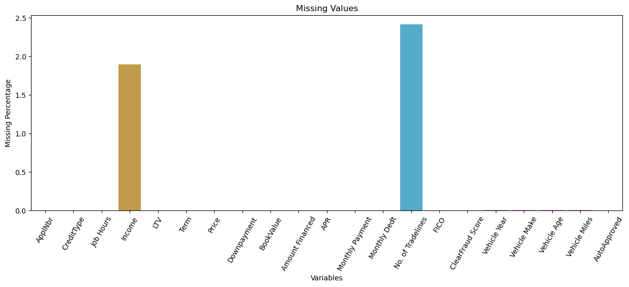
Missing Values

Slide 10
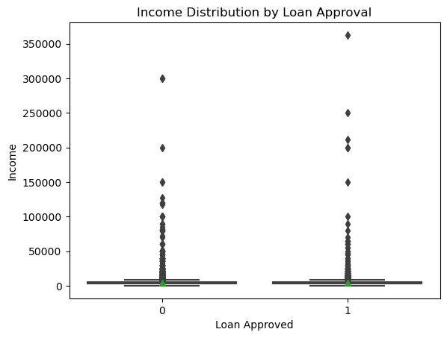

Slide 11
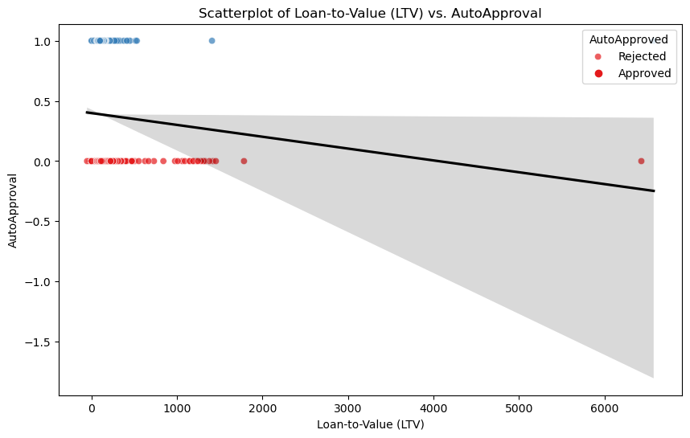

Slide 12
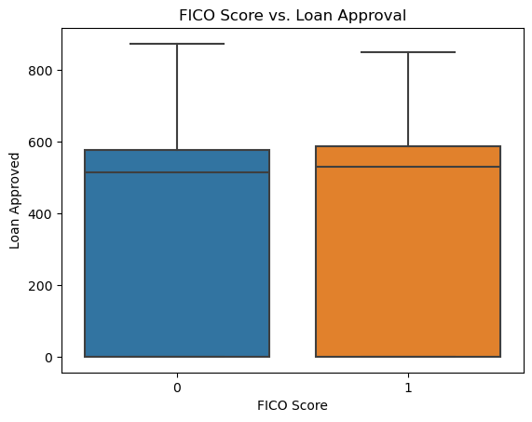

Slide 13
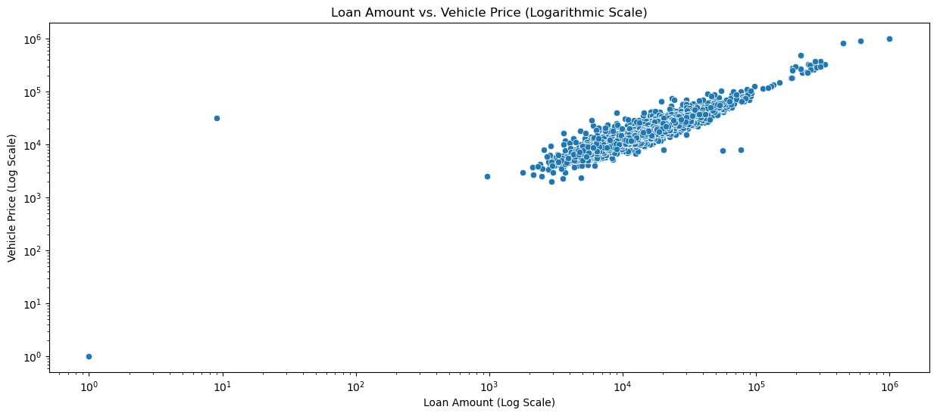

Slide 14
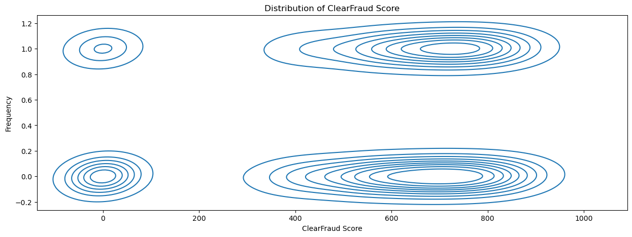

Slide 15
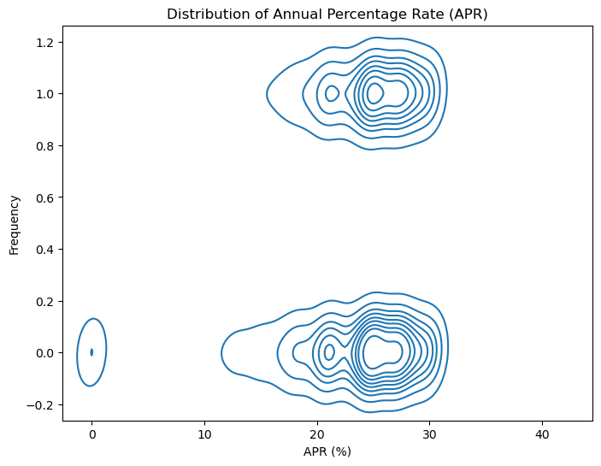

Slide 16
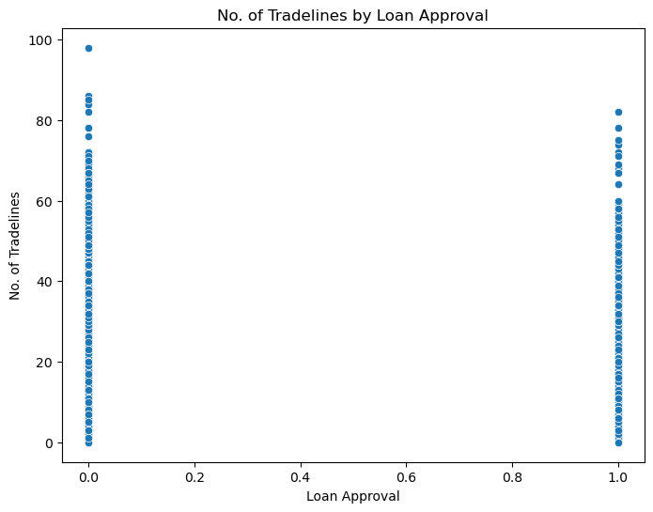

Slide 17
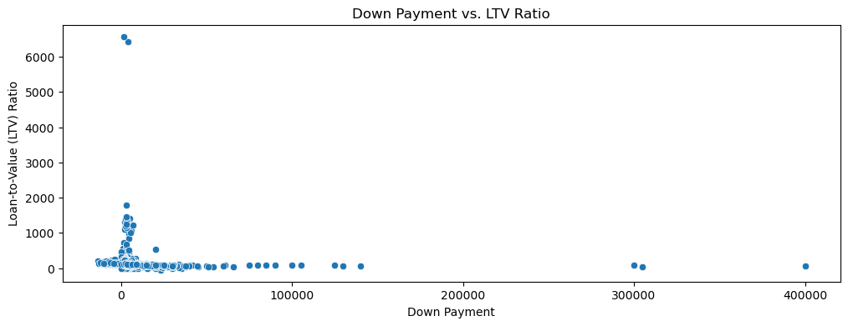

Slide 18
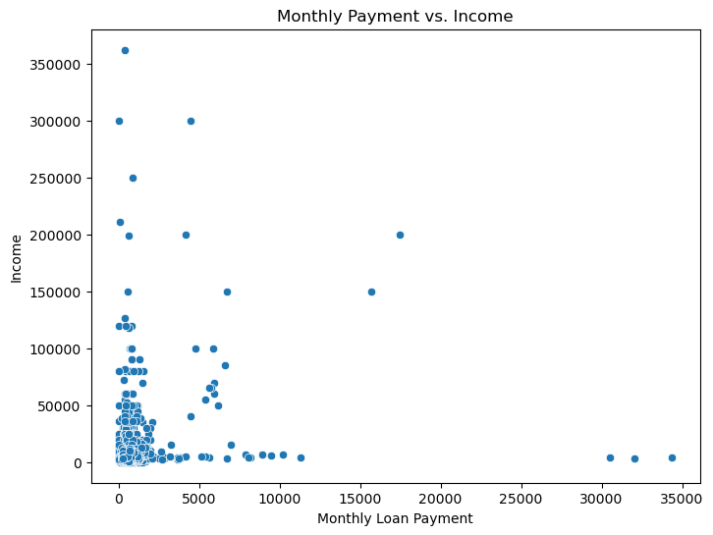

Slide 19
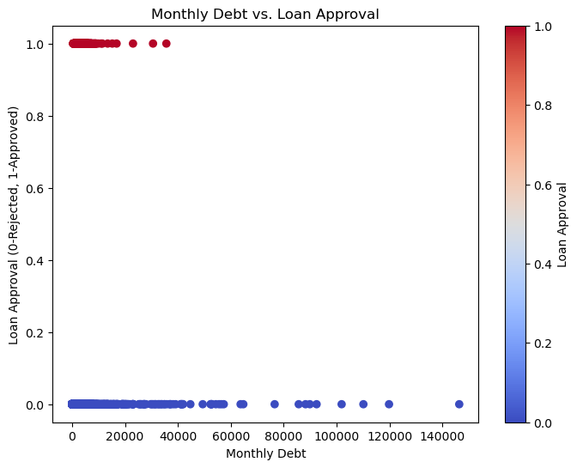

Slide 20
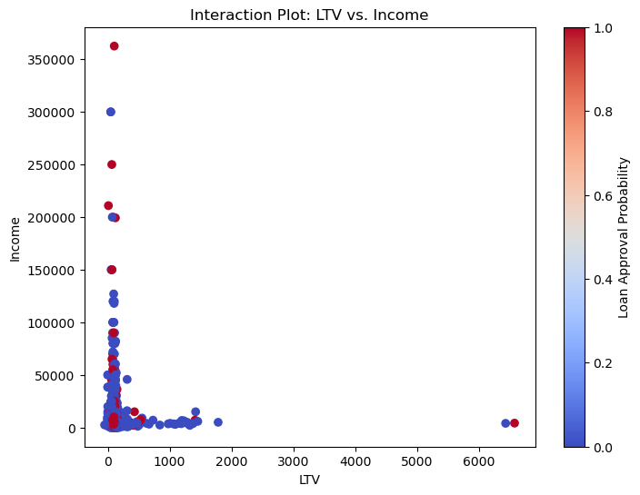

Slide 21
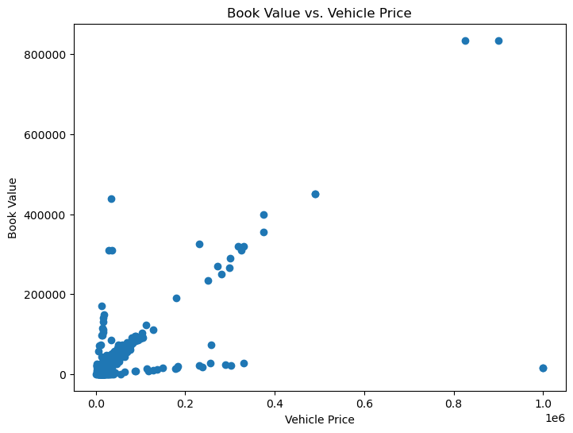

Slide 22
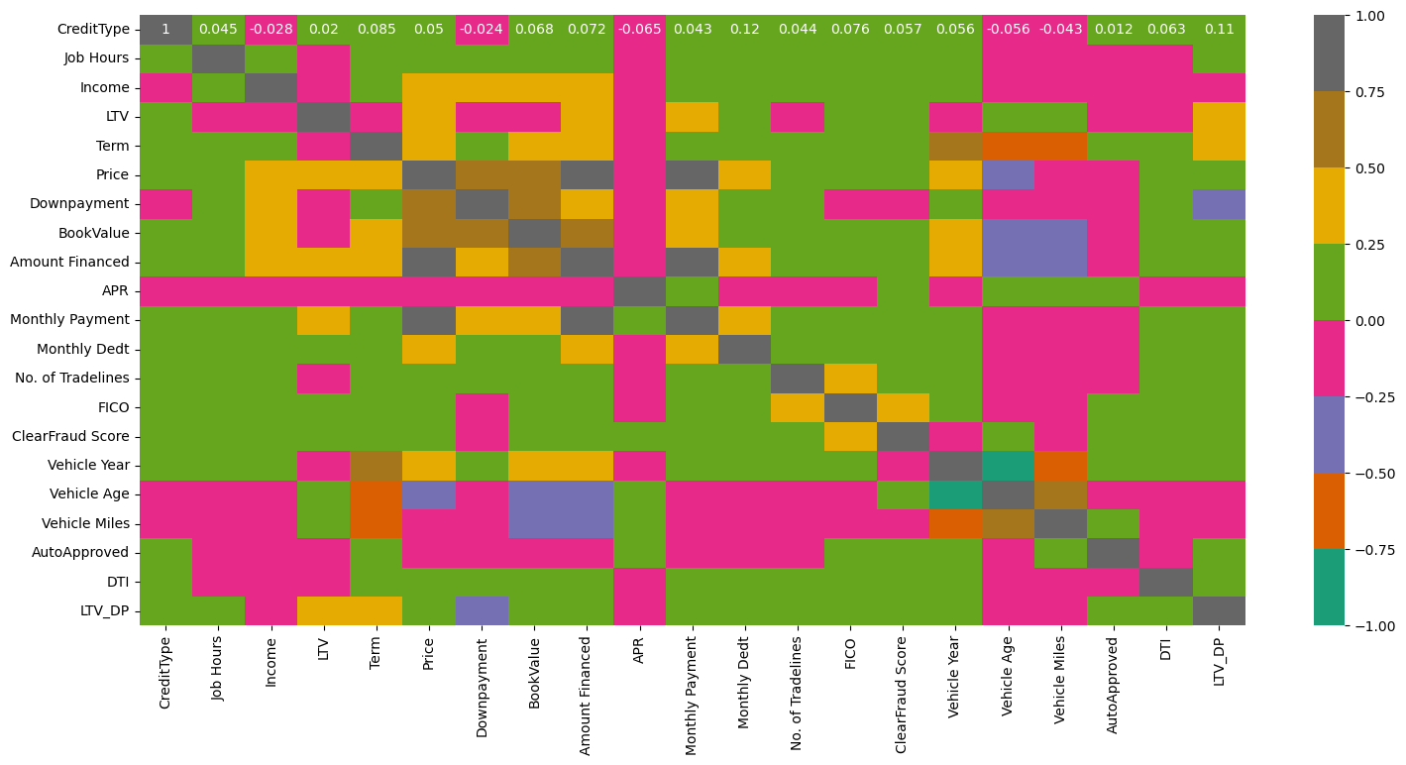

Slide 23
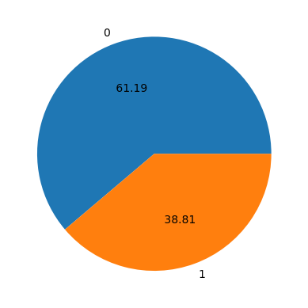
AutoApproved
Approved - 17987
Rejected - 11407

Slide 24
Gradient
Boosting
RANDOM FOREST
XGBoost
LOGISTIC REGRESSION
TRAINING
DATA
DATA PREPROCESSING
AND CLEANING
MODELS
DATA
TESTING
DATA
BEST MODELS
CONTENT DIAGRAM
PREDICTION

Slide 25
MODELS USED
Logistic Regression
Random Forest Classifier
XGB Classifier
Gradient Boosting Classifier
KNN
Gaussian Naive Bayes Classifier

Slide 26
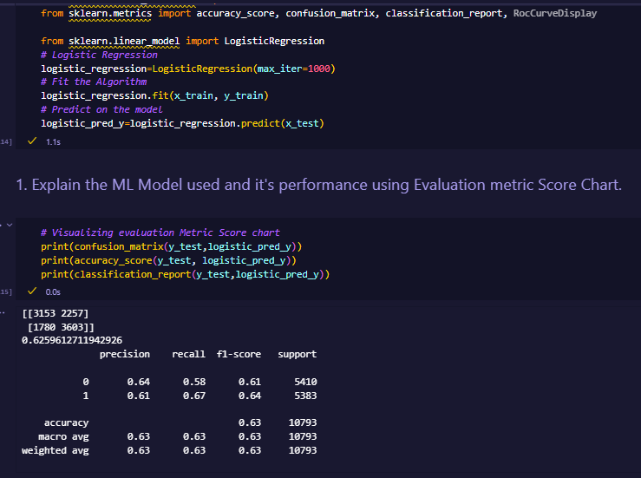
DATASET :
Model 1: Logistic Regression
LOAN PREDICTION DATASET
Precision 0(0.64), 1(0.61)
Recall 0(0.58), 1(0.67)
F1 Score 0(0.61), 1(0.64)
Accuracy 0.62

Slide 27
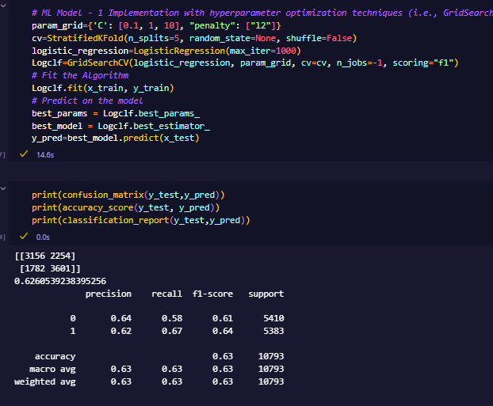
Model 1: Hyperparameter
Tuning
Precision 0(0.64), 1(0.62)
Recall 0(0.58), 1(0.67)
F1 Score 0(0.61), 1(0.64)
Accuracy 0.62

Slide 28
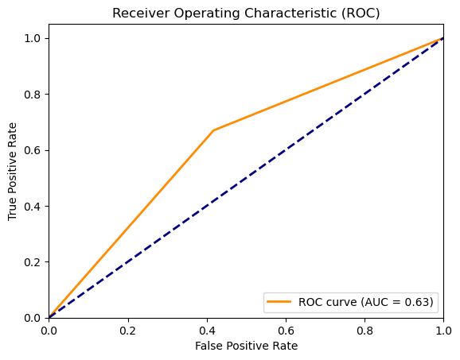
Model 1: ROC

Slide 29
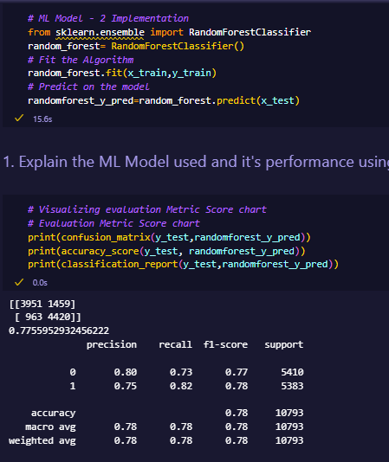
Model 2: Random Forest

Slide 30
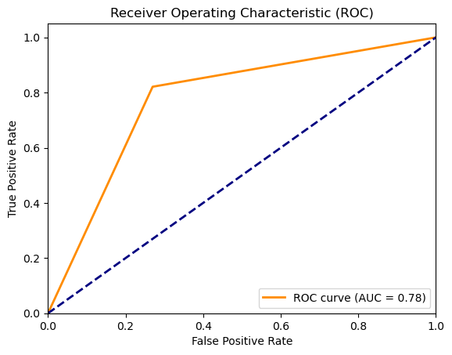
Model 2: ROC

Slide 31
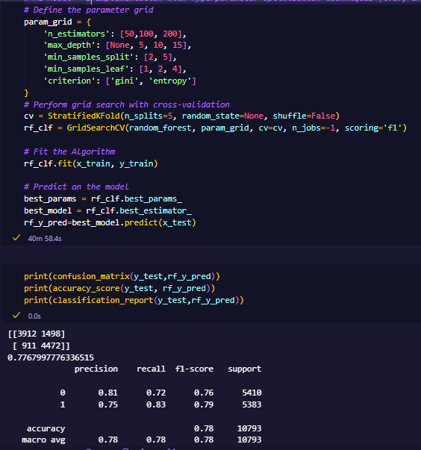
Model 2: Random Forest
Hyper-parameter Tuning

Slide 32
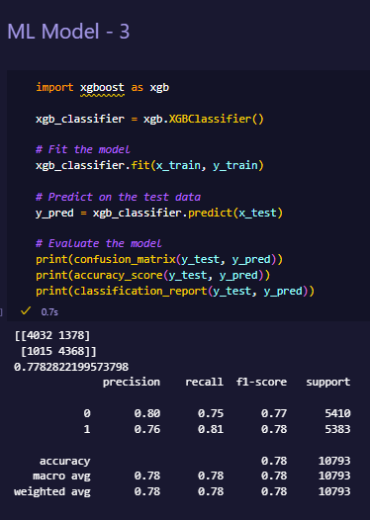
Model 3: XGBOOST

Slide 33
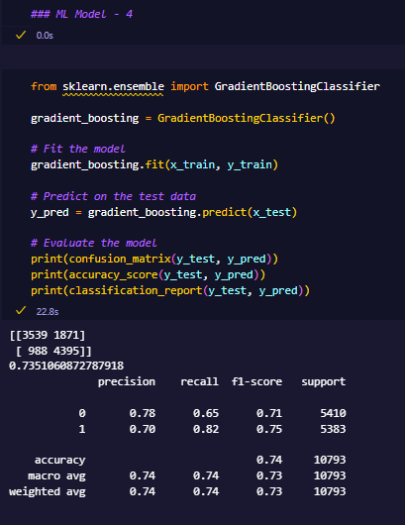
Model 4: Gradient Boosting

Slide 34
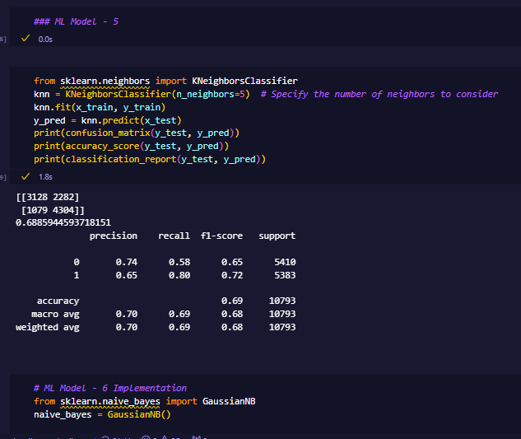
Model 5: KNN

Slide 35
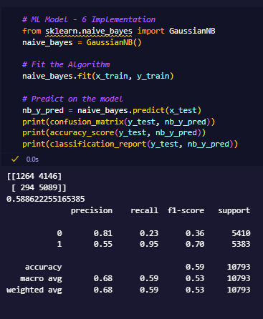
Model 6: Naive Bayes

Slide 36
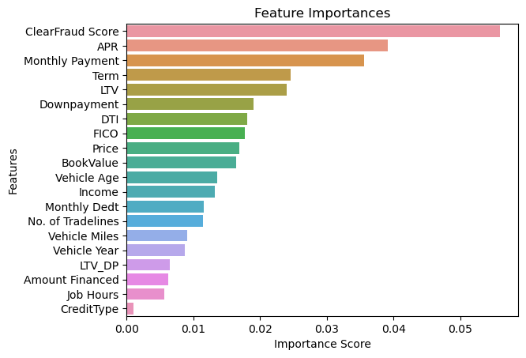
Feature Importance

Slide 37
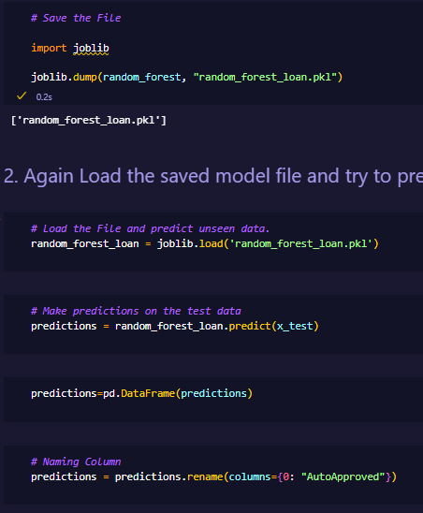
Model Saving and Loading

Slide 38
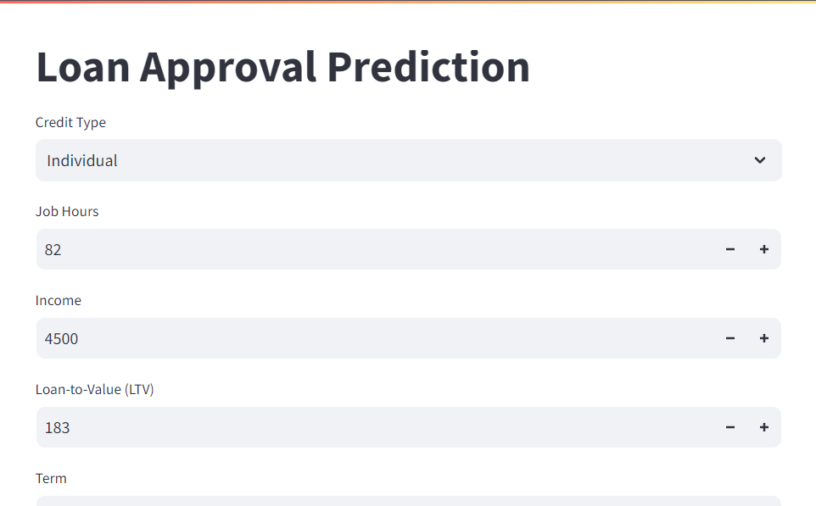
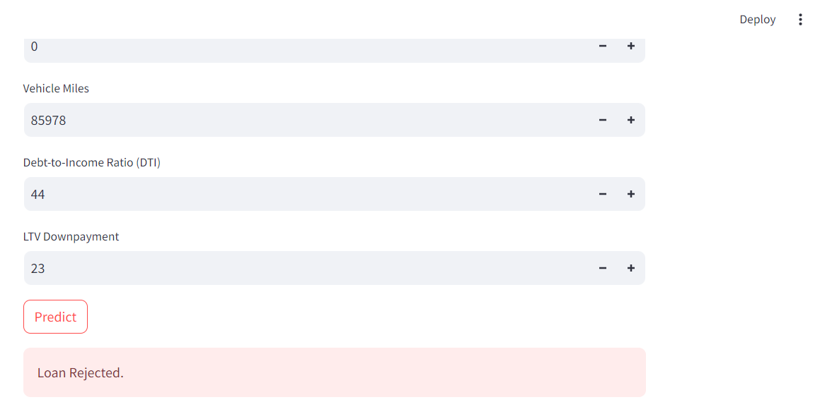
Model Deployment

Slide 39




CONCLUSION
We did Exploratory data Analysis on the features of this dataset and saw how each feature is distributed.
We calculated correlation between independent variables and found that applicant income and loan amount have significant relation.
We constructed models taking different variables into account and found it's odds ratio that credit history is creating the most impact on loan giving decision
We got good accuracy for all the four models

